Slide 1
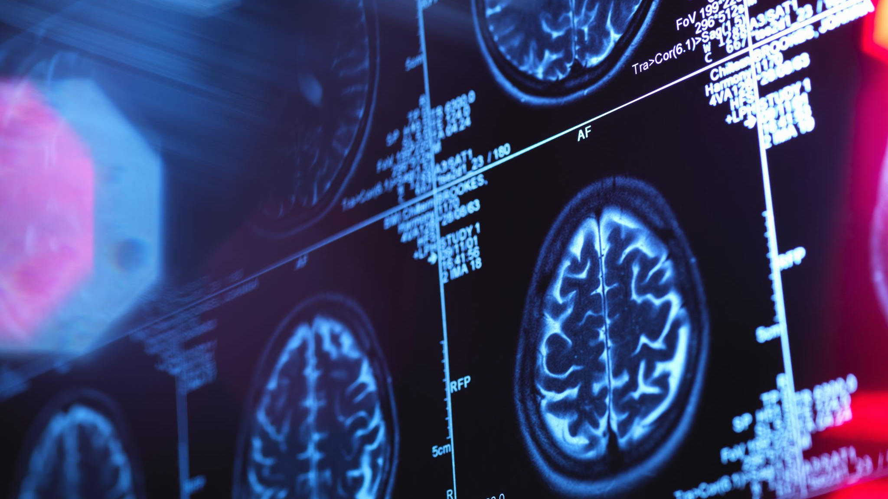
Nuisance Artifact Removal in fMRI
A Causal Discovery Approach
Olawale Salaudeen (CS), Vikram Duvvur (CS)
Faculty Advisors: Aron Barbey (PSYC), Brad Sutton (BIOE), Sanmi Koyejo (CS)

Slide 2
Outline
Introduction/Motivation
Background
Independent Component Analysis (ICA)
ICA-AROMA for denoising
Graph ICA-AROMA (Our work)
Causal discovery aided denoising

Slide 3
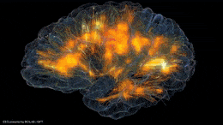
Notes:
The brain is essentially our control system, with at least tens of billions of neurons, roughly the same numbers of stars in the Milky Way, firing to generate personality, movement, breathing, and many more processes. Despite the clear importance of the brain, there is still a lot we don’t understand, specifically on how various parts of the brain are connected and communicate to yield behavior, generally.

Slide 4
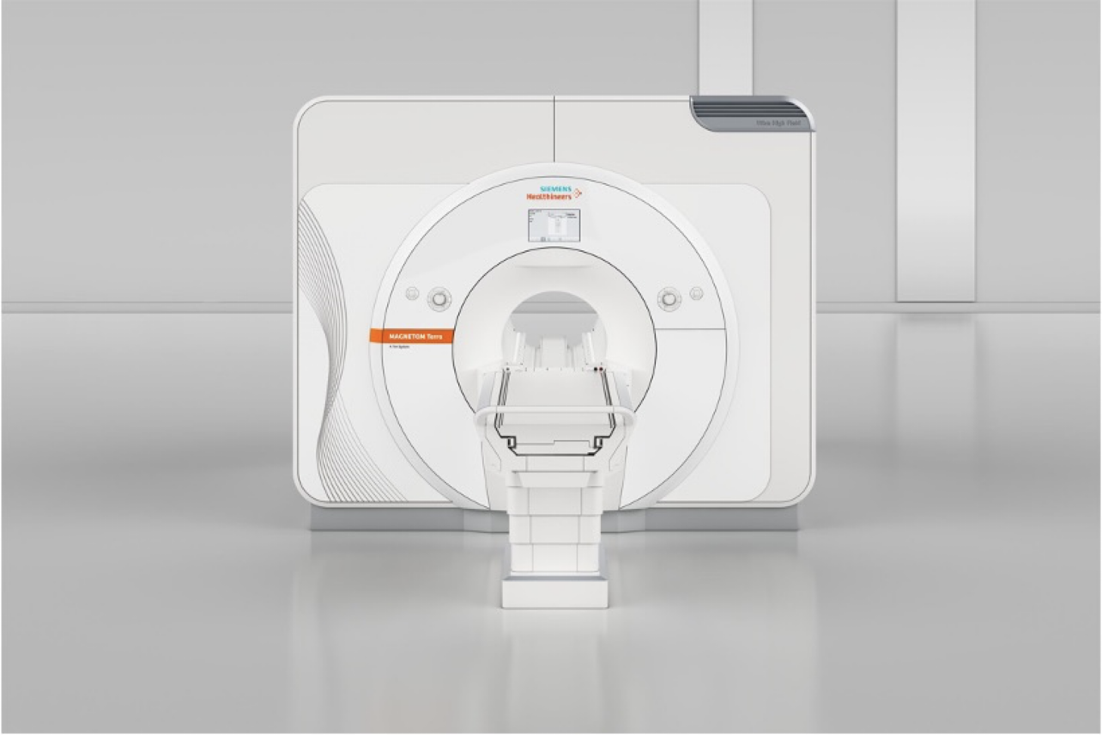
functional Magnetic Resonance Imaging (fMRI)
Notes:
One prominent tool to aide in understanding connectivity in the brain is functional Magnetic Resonance Imaging or fMRI.

Slide 5
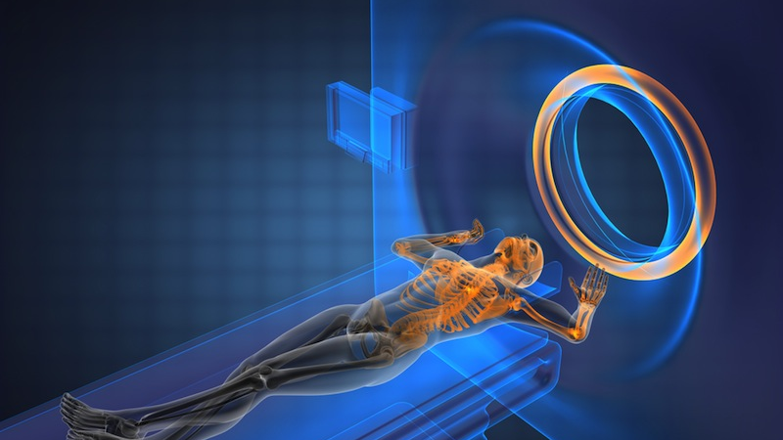
Notes:
So, again, with fMRI, we are just measuring changes in magnetic fields at relatively small spatial resolutions, across time.

Slide 6
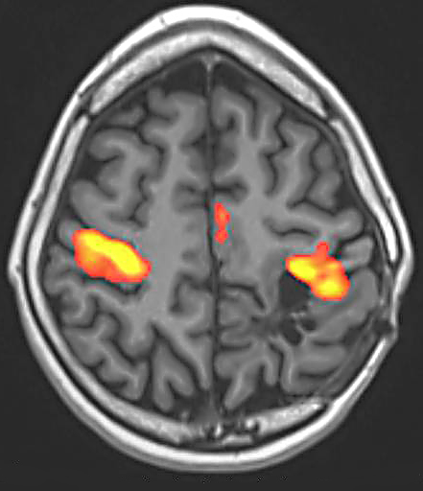
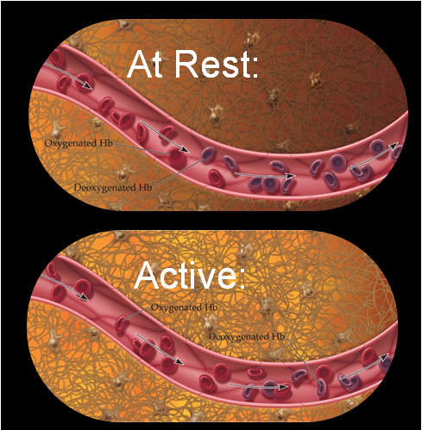
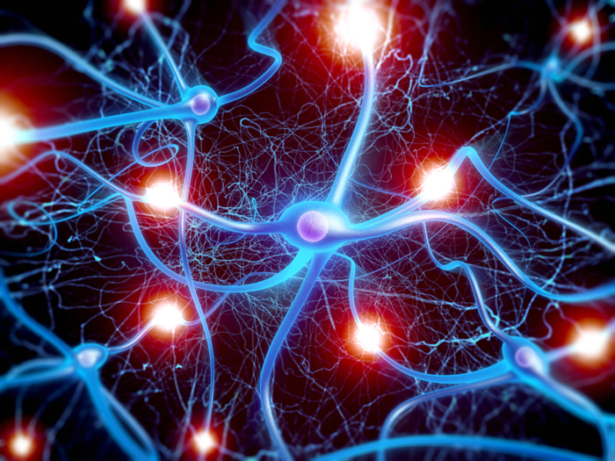
Task
↑ MRI Signal
Neural activity
↓ deoxy-Hb
   ↑ Blood flow
BOLD: Blood-Oxygen-Level-Dependent
6
Notes:
fMRI doesn’t directly measure neural activity in the brain; rather it measures a proxy of neural activity - blood-oxygen-level-dependent or BOLD signal.
As most of us know, blood supplies oxygen (or fuel) to brain cells
So, when a region of the brain becomes more active, there is an increase in blood flow to that region.
The new blood pushes out the deoxygenated blood in that region, which changes the magnetic properties of that region.
Essentially, a fMRI is a giant magnet that measures these magnetic property changes across time at a spatial resolution of as low as a few mms.
Though, it is believed that new advances in 7 Tesla magnets may lead to much smaller spatial resolution.

Slide 7
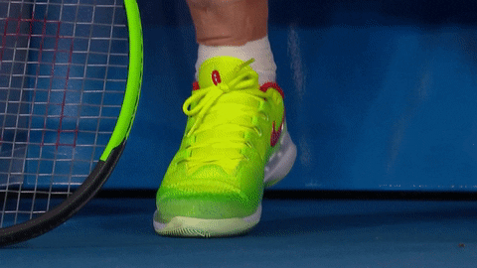
Nuisance Artifact Examples
Respiratory
Motion
Cardiac
7
Notes:
So-called nuisance artifacts like respiration, motion, and heart-beat can also affect the magnetic field. This is problematic because it may be the case that the measurements observed from fMRI are due to these nuisance processes rather than neural processes.

Slide 8
How can we mitigate the effects of these artifacts? ICA-AROMA
Raimon H.R. Pruim, Maarten Mennes, Daan van Rooij, Alberto Llera, Jan K. Buitelaar, Christian F. Beckmann, ICA-AROMA: A robust ICA-based strategy for removing motion artifacts from fMRI data, NeuroImage, Volume 112, 2015, Pages 267-277, ISSN 1053-8119, https://doi.org/10.1016/j.neuroimage.2015.02.064.

Slide 9
Independent Component Analysis (ICA)
A method to decompose observed data into the k independent sources that generated it.

Slide 10
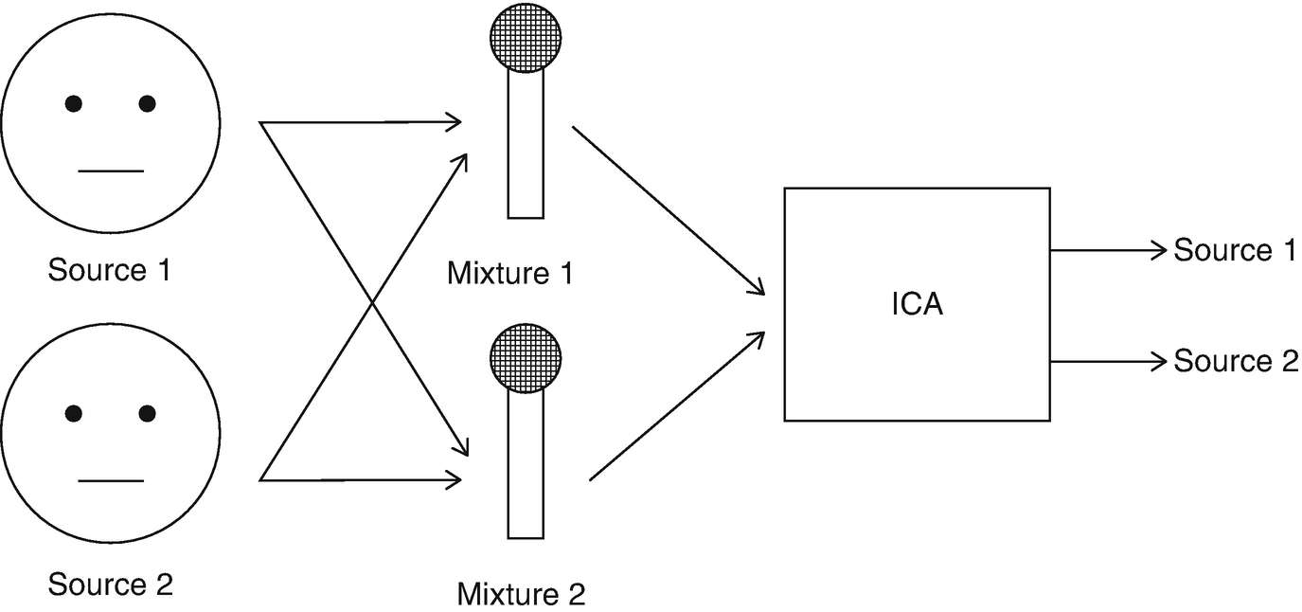
Independent Component Analysis
K=2 Independent Components
Observed
Magic
k=2 Independent Components
Voxel 1
Neural Activity 1
Neural Activity 1
Jittering
Jittering
Voxel 2
Voxel: Smallest area in fMRI scan; analogous to a pixel in an image.
10
Notes:
The canonical explanation of ICA is, suppose you have two people speaking in microphones – where both microphones can pick up the sound from the other person. For the purposes of this talk, it’s sufficient to think of ICA aroma as a black box method that can take the d measurements, in this case 2 microphones, generated by k sources, in this case two voices, and separate the sources, that is extract each person’s voice in distinctly; with some assumptions, of course.
Now, using the same cartoon example, we can replace the voices with some neural activity and jittering for instance. And replace the microphones with two voxels ( a voxel is basically a pixel representing the smallest area that can be measured). With ICA, we should be able to separate neural activity from jittering, or any other artifacts for that matter.

Slide 11
fMRI Scan $→k$ Independent Components
Independent Components (ICs): a distinct process (in some sense)
Some are neural activity
Some are nuisance artifacts
Which are neural activity, and which are nuisance artifacts?
11
Notes:
So essentially, we can take or fMRI scan and get back k sources (or Independent Components) representing distinct process. However, we still don’t know which of these ICs are neural activity and which are nuisance artifacts.

Slide 12
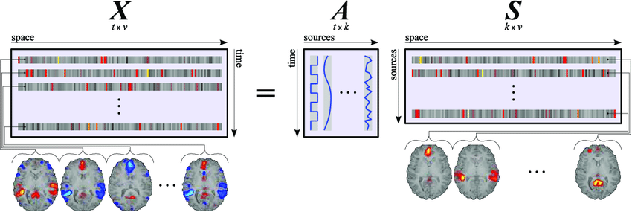
k Independent Components
Original Scan (flattened)
k’s across time
k’s across pace
$$IC_{1}$$
$$IC_{1}$$
12
Notes:
So, if we let X be the fMRI scan (usually 4d) but flattened to be 2d with a time axis and a space axis. ICA gives us a representation each IC across time and across space.

Slide 13
Properties of ICs across space and time.
Neural Activity vs. Artifact
Notes:
So, Pruim et al. looked these properties and manually derived features that are indicative of nuisance artifacts.

Slide 14
Spatial Nuisance IC properties
Independent Component i:
CSF (CSF fraction)
Independent Component j:
Motion (edge fraction)
Notes:
For instance, activity in the Cerebrospinal-Fluid (CSF) is typically extracted as its independent component, and we can algorithmically determine which ICs capture activations in the CSF, spatially. Also, we can look at what percent of these activation are on the edge the brain, which is a property of motion induced activation. There are also temporal features, such as the percent of high frequency content in an IC across time.

Slide 15
Raimon H.R. Pruim, Maarten Mennes, Daan van Rooij, Alberto Llera, Jan K. Buitelaar, Christian F. Beckmann, ICA-AROMA: A robust ICA-based strategy for removing motion artifacts from fMRI data, NeuroImage, Volume 112, 2015, Pages 267-277, ISSN 1053-8119, https://doi.org/10.1016/j.neuroimage.2015.02.064.
Notes:
So instead of going though each scan, and manually identifying these components, Pruim et. al. created a classifier through machine learning that automatically classifies ICs as motion based on the features they identified. Once identified, the effects of the ICs can be removed from the original fMRI scan, hopefully giving us a clearer picture of neural activity.

Slide 16
Are these all the artifacts?
No! What can we do now?
Notes:
However, ICA-AROMA mostly identifies artifacts based on properties at the machine level, that is the effect of motion at the machine level. However, what about the effect of these artifacts at the biological level. This is a lot harder because we don’t necessarily know what properties those features might have.

Slide 17
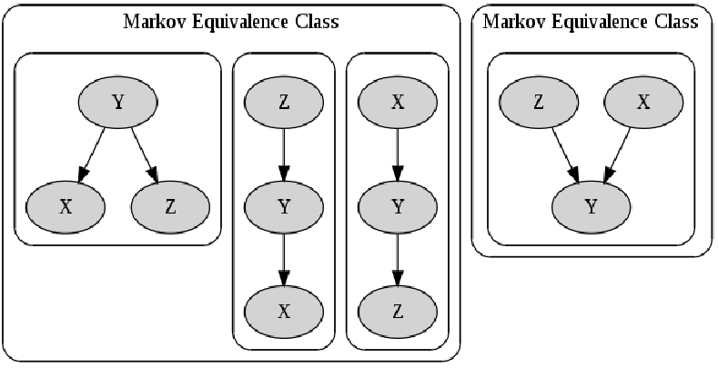
Reichenbach Common Cause
$X$, $Z$ are correlated, but not directly causal.
There exists a Y that is responsible for this correlation
$X$_∣∣_ Z
$X$_∣∣_ Z | Y
$X$‖ Z | Y
$X, Y, Z$ correspond to (spatially) Independent Components’ timeseries
_∣∣_ : independent; ‖ NOT independent
Notes:
Our work is motivated by the so-called Reichenbach common cause principle, which says that two events that are correlated either have a direct causal edge or there is a third event that is responsible for said correlation. If we consider two events, X, Z that are correlated but not directed causes, then there is a Y that induces this correlations.
It’s either the case that Y is a common cause of X and Z, or Y mediates the effect of X on Z and vice versa.
One there interesting possibility for the correlation is that X and Z are actually marginally independent but become dependent when you condition on Y.
These relationships are called Markov equivalent classes because they are generally equivalent in joint distribution.
Nevertheless, we can apply a class of causal discovery algorithms to learn a directed graph representing the generative process of the IC temporal dynamics by searching for graphs that satisfy these Markov properties.

Slide 18
Graph Criterion: Only non-nuisance in neighborhood (adjacency)
Correlations
Causation
CAUSAL DISCOVERY
$X, Y, Z, …$ correspond to (spatially) Independent Components’ timeseries
Nuisance
Notes:
We can then develop criteria based on local adjacencies to identify latent nuisance artifacts that are not necessarily identifiable by known spatial and temporal features.

Slide 19
Evaluation
Quality Control-Functional Connectivity (QC-FC)
Correlation w/ realignment parameters
Distance dependence of connectivity strength
Prediction Task Error
Post-processed connectome → Cognitive measures

Slide 20
Takeaways
Nuisance artifacts can hinder accurate/precise inferences
We can decompose fMRI into distinct components
Use spatial and temporal properties of components to identify some artifacts
Use causal discovery to discover identify latent artifacts

Slide 22
Contact: oes2@illinois.edu Webpage: olawalesalaudeen.com Acknowledgements: Evan Anderson (Neuro) and Paul Camacho (Neuro)

